Slide 1

OPENSHIFT ENTERPRISE
TRAINING
PRESENTED
BY
GRANT
SHIPLEY
MICIAH
MASTERS

Slide 2




AGENDA
Introductions
Overview
Installation
Usage

Slide 3

WHO AM I?
Senior Manager, OpenShift Evangelists
Really, I am a Developer Evangelist
Red Hat (8 Years), Novell (2 years), Caldera / SCO (5 years)
Java / PHP / Node.js / Mobile /MongoDB / MySQL/ PostgreSQL
Open source projects

Slide 4

WHO IS MICIAH?
Miciah Masters
Software Engineer, OpenShift Enterprise
Started at Red Hat in July 2012
C / shell / GNU/Linux system administration
Open source project

Slide 5

WHO ARE YOU?

Slide 6

WHAT WILL YOU LEARN?
How to install OpenShift Enterprise 2.0
How to configure and administer OpenShift Enterprise
How to add cartridges
How to use OpenShift Enterprise for deployment
How to use OpenShift Enterprise for development

Slide 7

ASSUMPTIONS
You want to learn how to use OpenShift Enterprise
You can write some form of code
You have your own laptop
You will ask questions
You know how to use Red Hat Enterprise Linux
You have an SSH client installed on your laptop

Slide 8

TRAINING SCHEDULE
Some lecture
Mostly labs
Let’s set our break schedule
Lunch (the most important thing)

Slide 9

BORING........
DEMO

Slide 10


HOUSEKEEPING
CLASS MATERIAL
OpenStack
Lab Manual
Online Material
SWAG
Two virtual machines
Broker Host
Node Host
RHEL Pre-installed
22 Labs (less talking - more doing)
training.runcloudrun.com
HTML and PDF manual
Red Hats
USB Bottle openers

Slide 11
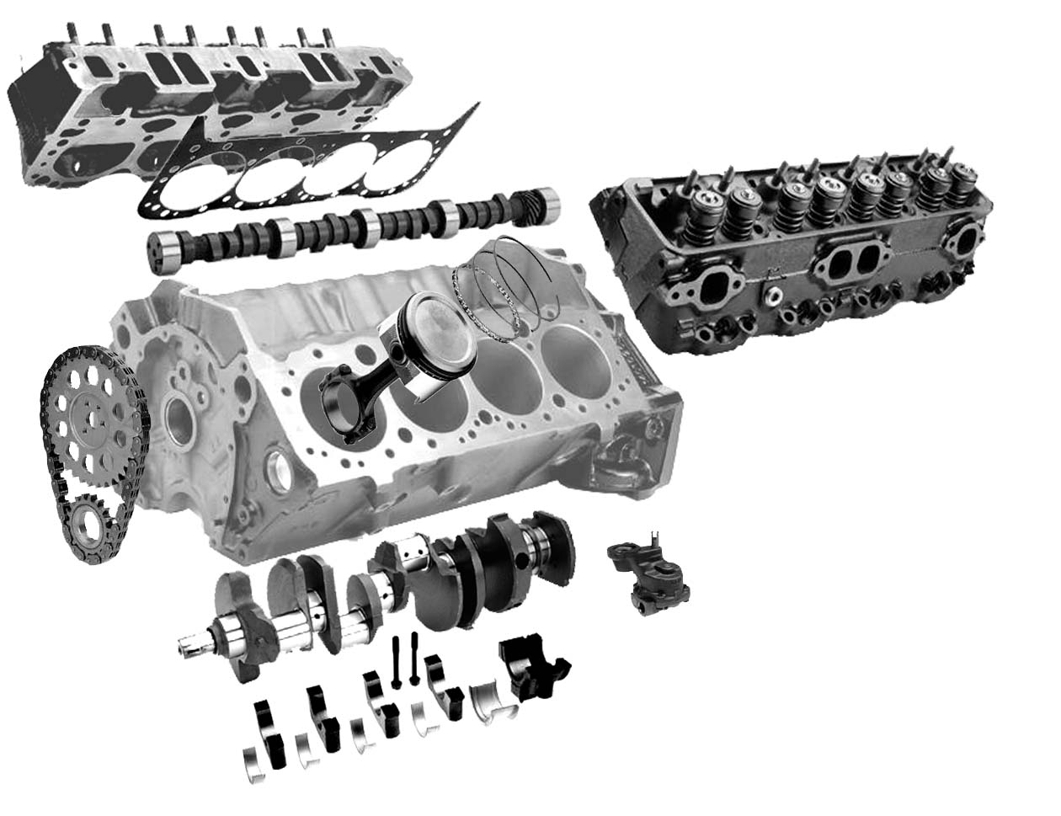
LAB MANUAL
Divided into three parts
Installation and Configuration
Administration
Usage

Slide 12

OpenShift
HISTORY

Slide 13

OpenShift
CLOUD OVERVIEW

Slide 14

LEVEL SET
Cloud computing will
Feed all the children
Shelter all the homeless
Create world peace
Save us from the zombie apocalypse
Automagically correct your terrible photos

Slide 15
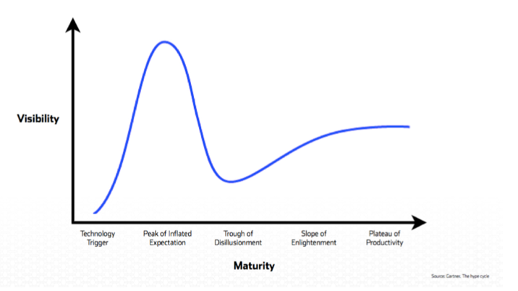

HYPE CYCLE

Slide 16
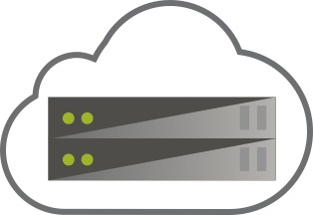
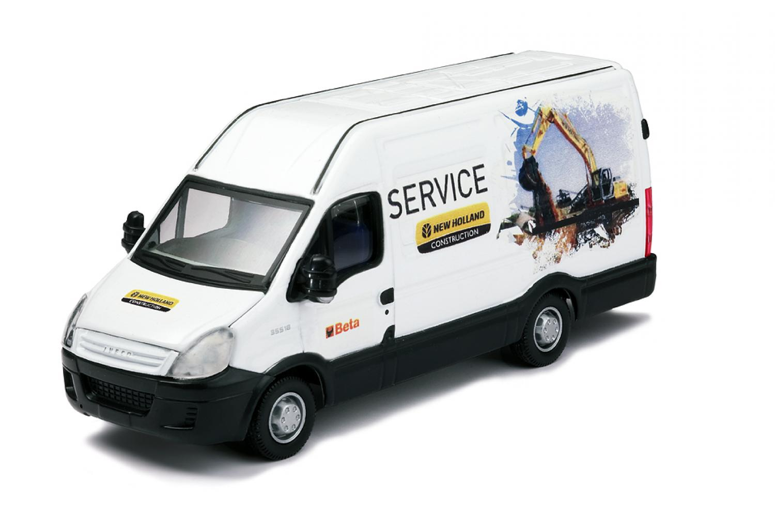
IaaS
Servers in the Cloud
You must build and manage everything
(OS, App Servers, DB, App, etc.)
“How do I use this?”

Slide 17



SaaS
Someone else’s app in the Cloud (CRM, etc.)
You are restricted to the features of the 3rd Party application
“I’m not sure this does what I need.”

Slide 18


PaaS
Quickly build the Application that YOU need for
Your Group, your Enterprise, your next great idea!
Big data, mobile, social
You code the application, We run it for you
Leverage the ease, scale and power of the Cloud
Code
Deploy
Enjoy

Slide 19

EVERYONE GETS ALONG
Operations care about stability and performance
Developers just want environments without waiting
OpenShift Enterprise creates a peaceful
environment for both parties

Slide 20
OpenShift
OPENSHIFT OVERVIEW

Slide 21

KEY TERMS
Broker – Management host, orchestration of Nodes
Node – Compute host containing Gears
Gear – Allocation of fixed memory, compute, and storage resources for running applications
Cartridge – A technology/framework (PHP, Perl, Java, MySQL, etc.) to build applications
Client Tools – CLI, Eclipse, Web Console for creating and managing applications

Slide 22



FLAVORS OF OPENSHIFT
Open Source Project
origin
Public Cloud Service
On-premise or Private Cloud Software

Slide 23
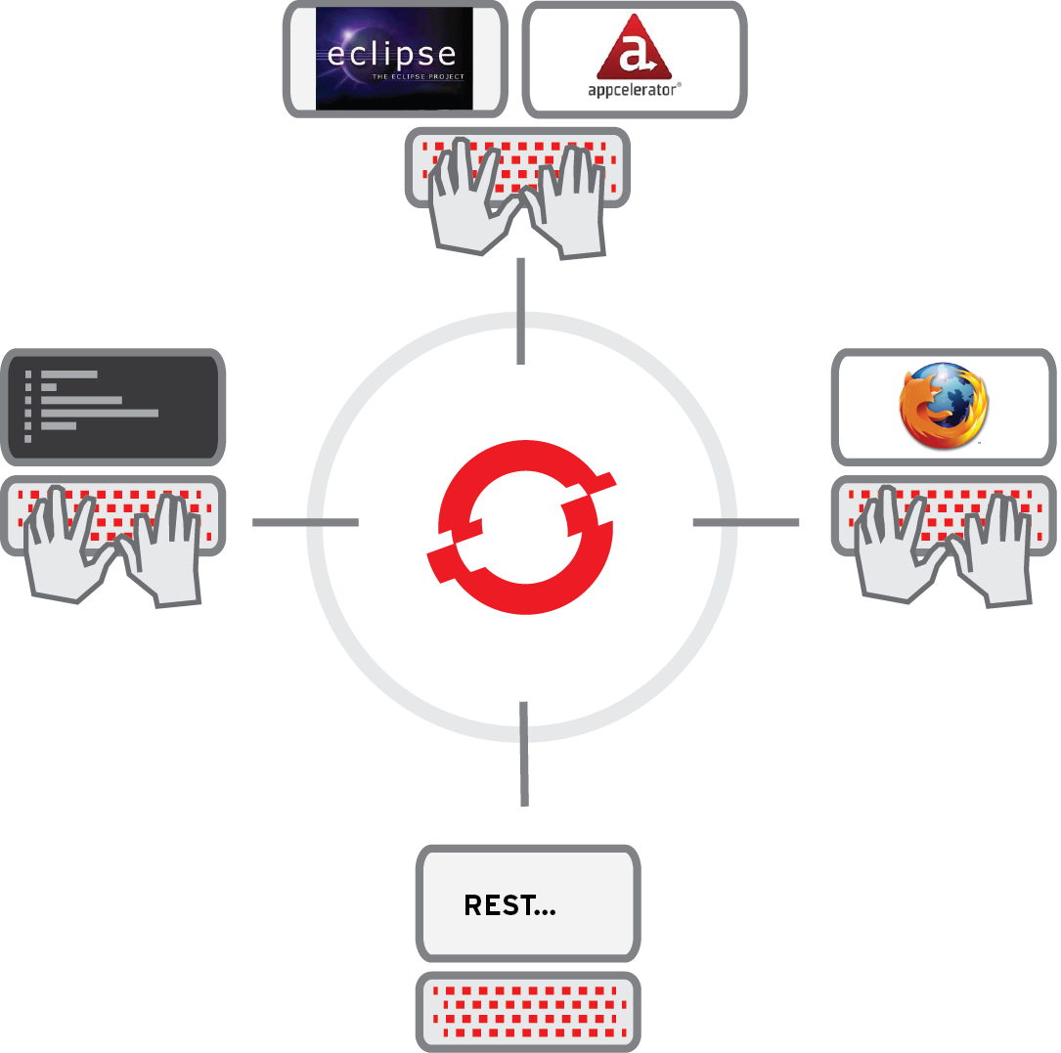
INTERACTIONS
Developer IDE
Integrations
Command Line
Tooling
Web Browser
Console
REST APIs

Slide 24

RUNS ON IaaS
OpenShift Enterprise is a PaaS that runs on top of..... Infrastructure
Amazon EC2
Rackspace
Bare Metal
OpenStack
RHEV
VMWare

Slide 25
FOUNDATION
The foundation of OpenShift Enterprise is Red Hat Enterprise Linux
RHEL
RHEL
RHEL
RHEL
RHEL
RHEL

Slide 26

SERVER TYPES
Each OpenShift Enterprise server will be one of the following types:
Broker Host
Node Host

Slide 27
BROKER
An OpenShift Broker can manage multiple node hosts.
Nodes are where User Applications live.
RHEL
RHEL
RHEL
Brokers
Node
Node

Slide 28
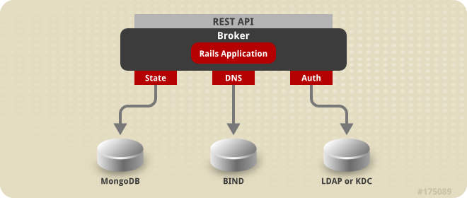
BROKER
The Broker is responsible for state, DNS, and authentication.

Slide 29
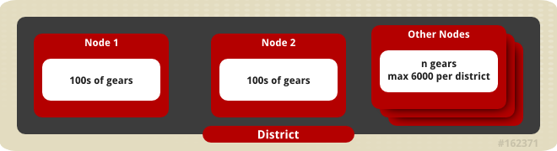
NODE
The node hosts are responsible for holding application gears.

Slide 30
SELINUX
SELinux Policies securely subdivide
the Node instances.
RHEL
RHEL
Brokers
Node
Node

Slide 31
GEARS
OpenShift GEARS represent secure containers in RHEL
RHEL
RHEL
Brokers
Node
Node

Slide 32

WORKFLOW
Web Console
Eclipse IDE
Cmd Line
OpenShift
Gear
RHEL
RHEL
Brokers
Node
Node

Slide 33
CARTRIDGES
Web Console
Eclipse IDE
Cmd Line
MYSQL
JBOSS
RHEL
RHEL
Brokers
Node
Node

Slide 34
CARTRIDGES
Java
MySQL
PHP
Postgres
CUSTOM
Python
Etc.
Ruby
Etc.
OpenShift Default
Cartridges

Slide 35
WORKFLOW
Git Protocol / ssh
Push
Developer pushes application code via GIT source code management system
Code
Git
Repo
MySQL
JBoss
RHEL
RHEL
RHEL
Broker
Node
Node
Node
Notes:
So, once the Gear is fully configured and Cartridges are installed, the Developer can then begin coding. As code is completed, the Developer pushes the code to OpenShift via the Git protocol. Git is a popular Source Code Control system used in the Open Source development world. A Git repository is created in the Gear and the Developer uses the Git “Push” command, or the IDE, to push the latest code into the repository over an SSH encrypted channel using the Git protocol.
Depending on the programming language, once the code is pushed, the application will show the updates immediately. This accelerates the Application Development Lifecycle by providing immediate feedback on application changes.
<next slide>
35

Slide 36
SCALING
HA-Proxy
Code
Code
Code
Java
Java
Java
RHEL
MySQL
Notes:
And, once the application is launched within the OpenShift PaaS, OpenShift provides the elasticity expected in a Cloud Application Platform by automatically scaling the application as needed to meet demand.
When created, applications can be flagged as “Scalable” (some apps may not want to be scaled). When OpenShift sees this flag, it creates an additional Gear and places an HA-Proxy software load-balancer in front of the application. The HA-Proxy then monitors the incoming traffic to the application. When the number of connections to the application crosses a certain pre-defined threshold, OpenShift will then horizontally scale the application by replicating the application code tier of the application across multiple Gears.
For JBoss applications, OpenShift will scale the application using JBoss Clustering which allows stateful or stateless applications to be scaled gracefully. For Ruby, PHP, Python, and other script-oriented languages, the application will need to be designed for stateless scaling where the application container is replicated across multiple gears. The Database tier is not scaled in OpenShift today.
Automatic application scaling is a feature that is unique to OpenShift among the popular PaaS offerings that are out there.
Automatic scaling of production applications is another example of how OpenShift applies automation technologies and a cloud architecture to make life better for both IT Operations and Development.
<next slide>
36

Slide 37
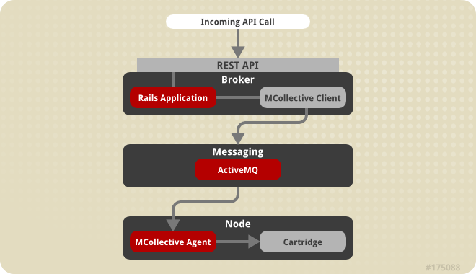
COMMUNICATION
Communication from external clients occurs through the REST API
The Broker then communicates through the messaging service to nodes

Slide 38
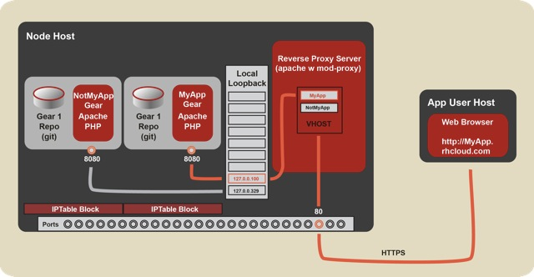
HTTP FLOW
Notes:
OpenShift Origin - Port Proxy
Linux handles the loopback interface's 127.0.0.0/8 address block specially: A request from an address in this block can only go to an address in the same block (put another way, a connection on the loopback interface is confined to the loopback interface). OpenShift uses this fact to contain hosted applications: a gear is prohibited by iptables from listening on an external network interface, and so a given gear can only respond to connections that come from processes on the same node.
For the common case of Web connections, the system Apache instance acts as a reverse proxy, forwarding requests that come in on the external interface to the appropriate 127.x.y.z address; see the documentation on the node component.
However, sometimes gears need to accept other types of connections. The two most common such scenarios are the following:
A gear needs to connect to another gear (which may be on the same node or another node).
A gear needs to listen for connections on a public interface besides HTTP connections to port 80.
For example, a game server needs to expose a port to receive incoming connections from clients, and a database needs to expost a port so that other gears can connect to it.
To meet these needs, OpenShift uses haproxy to proxy TCP connections between an external-facing network interface and the loopback interface. Each gear is assigned five exposable ports, and the gear may establish a forwarding rule for each of these ports to forward connections on the the port on the external interface to an arbitrary port on the gear's assigned loopback address.
To provide haproxy with adequate ports, we shift the ephemeral port range down to 15000-35530, so that Linux will not use ports outside of this range for connections for which no port is given explicitly. This means that ports 35531-65535 will be available for haproxy's exclusive use.
Note: Given that each gear is assigned 5 ports, this imposes a limit of 6000 gears per node.
The interaction with haproxy is implemented on the cartridge side in cartridges/openshift-origin-cartridge-abstract/abstract/info/lib/network
and:
OpenShift Origin - Node Component
Hosted applications are run in containers called "gears." These gears are run on hosts (which can be physical hosts or virtual machines) called "nodes."
Each node runs a system Apache instance with mod_proxy that listens on port 80 on a public-facing network interface. Each gear is assigned an address in the 127.0.0.0/8 block, and a hosted Web application listens on port 8080 on its assigned private 127.x.y.z address.
When a Web client requests a URL for a hosted Web application, the request goes to the node's system Apache instance. The system Apache instance examines the virtual-host header (the "Host:" HTTP header) and dispatches the request to the 127.x.y.z:8080 private address of the appropriate gear.
For an explanation of how connections other than regular HTTP connections are handled, see the documentation on the port-proxy.

Slide 39
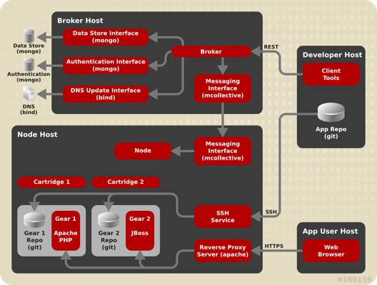
COMPLETE PICTURE

Slide 40
KEY TERMS
Broker – Management host, orchestration of Nodes
Node – Compute host containing Gears
Gear – Allocation of fixed memory, compute, and storage resources for running applications
Cartridge – A technology/framework (PHP, Perl, Java, MySQL, etc.) to build applications
Client Tools – CLI, Eclipse, Web Console for creating and managing applications

Slide 41

LAB 1
Read the overview chapter

Slide 42

LAB 1
QUESTIONS?

Slide 43

LAB 2
Subscription Management

Slide 44
LAB 2
QUESTIONS?

Slide 45

LAB 3
Installation using openshift.sh

Slide 46
LAB 3
QUESTIONS?

Slide 47

LAB 4
Verification of install

Slide 48
LAB 4
QUESTIONS?

Slide 49

LAB 5
Configure local machine (your laptop), for DNS resolution

Slide 50
LAB 5
QUESTIONS?

Slide 51

LAB 6
List available cartridges
Install JBoss cartridges
Clearing broker application cache
Install PostgreSQL cartridge
Install DIY cartridge

Slide 52
LAB 6
QUESTIONS?

Slide 53

LAB 7
Managing resources
Default gear quota and size
Number of allowed gears
Configuring gear types for a user

Slide 54
LAB 7
QUESTIONS?

Slide 55

LAB 8
Introduction to districts
Enable districts
Populate district with node host
Configure district capacity

Slide 56
LAB 8
QUESTIONS?

Slide 57

LAB 9
Install RHC client tools
Windows
OS X
Linux
Any OS with Ruby

Slide 58
LAB 9
QUESTIONS?

Slide 59
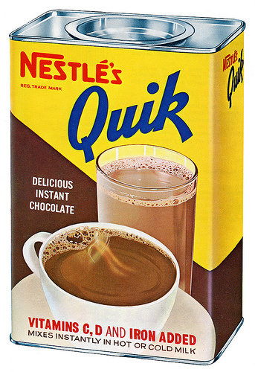
LAB 10
Configure RHC tools (broker.example.com)
Run rhc setup

Slide 60
LAB 10
QUESTIONS?

Slide 61

LAB 11
Creating our first application (wait, really? – Yes, finally.)
Understanding directory structure
Edit the source code
Deploy changes to your gear
Enable hot deployment

Slide 62
LAB 11
QUESTIONS?

Slide 63

LAB 12
Managing Applications
Cleaning up applications
Start / Stop / Restart applications
Viewing application details
SSH to application gear
Viewing log files
Adding custom domain names
Deleting an application

Slide 64
LAB 12
QUESTIONS?

Slide 65
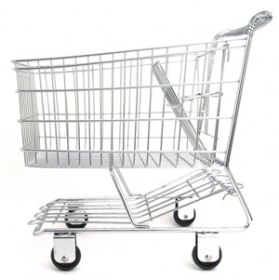
LAB 13
Using cartridges
Adding MySQL to an application
Modify PHP code to use MySQL
Managing cartridges
Using port forwarding

Slide 66
LAB 13
QUESTIONS?

Slide 67

LAB 14
Using the web console

Slide 68
LAB 14
QUESTIONS?

Slide 69

LAB 15
Using the admin console
Today is brought to
You by the letter A
for Admin

Slide 70
LAB 15
QUESTIONS?

Slide 71

LAB 16
How scaling works
Create a scaled application
Automatic scaling
Manual scaling

Slide 72
LAB 16
QUESTIONS?

Slide 73

LAB 17
Create a DIY application
Start and Stop scripts

Slide 74
LAB 17
QUESTIONS?

Slide 75

LAB 18
Create a JBoss EAP application
Adding marker files
Building a TODO application
Enable CDI
Creating RESTful web service
Deploying Java applications

Slide 76
LAB 18
QUESTIONS?

Slide 77

LAB 19
Using Jenkins for CI
Adding a Jenkins server
Configuring Jenkins builder
Adding Jenkins to your Java application

Slide 78
LAB 19
QUESTIONS?

Slide 79

LAB 20
Using JBoss Tools
Downloading Eclipse
Installing JBoss Tools
Configure JBoss Tools
Creating applications
Viewing logs
Port forwarding
Setting up database in Eclipse

Slide 80
LAB 20
QUESTIONS?

Slide 81

LAB 21
Using quick starts

Slide 82
LAB 21
QUESTIONS?

Slide 83

LAB 22
Creating your own quick start

Slide 84
LAB 22
QUESTIONS?

Slide 85

DONE!

